Slide 1
Greedy and Dynamic Programming
S K Verma

Slide 2
INTRODUCTION
Greedy and Dynamic Programming are two powerful techniques in algorithm design.
They are used to solve optimization problems efficiently.
Understanding their principles and differences is crucial for tackling a wide range of computational problems.
Also to consider certain parameters before applying any of these.

Slide 3
Choice Between Greedy and Dynamic Programming
Greedy algorithms are preferred when the problem exhibits the greedy-choice property and optimal substructure.
Dynamic Programming is suitable when the problem can be broken down into overlapping sub-problems with optimal substructure.
Understanding the problem's characteristics is essential for selecting the appropriate technique.

Slide 4
Deciding whether to apply a greedy or dynamic programming approach to solve a problem depends on several key parameters and characteristics of the problem. Here are some factors to consider:

Slide 5
1. Optimal Substructure:
Greedy:
Optimal solution can be constructed from locally optimal choices.
Eg: Finding the shortest path in a graph using Dijkstra's algorithm.
Dynamic Programming:
Optimal solution can be derived from optimal solutions to sub-problems.
Eg: Calculating the nth Fibonacci number using memoization.

Slide 6
2. Overlapping Sub-problems:
Greedy:
If the problem does not have overlapping sub-problems, a greedy approach is usually sufficient.
Eg: Coin Change Problem where each coin can only be used once.
Dynamic Programming:
If the problem can be broken down into overlapping sub-problems, dynamic programming is more appropriate.
Eg: Coin Change Problem where coins can be reused to make change.

Slide 7
3. Greedy Choice Property:
Greedy:
Makes locally optimal choices expecting a globally optimal solution.
Eg: Fractional Knapsack Problem, where items can be divided and selected based on their value-to-weight ratio.
Dynamic Programming:
Evaluates all possible choices for optimal solution.
Eg: 0/1 Knapsack Problem, where items cannot be divided, and a subset must be chosen to maximize value without exceeding the weight limit.

Slide 8
4. Complexity and Efficiency:
Greedy:
Simple and efficient but may not always provide optimal solution.
Eg: Activity Selection Problem, where activities with the earliest finish times are chosen iteratively.
Typically requires less memory.
Eg: Huffman Coding for data compression, which constructs a binary tree based on the frequency of characters.
Dynamic Programming:
Dynamic programming can guarantee the optimal solution but may be more computationally expensive.
Eg: Longest Common Subsequence Problem, where all possible subsequences must be examined to find the longest common subsequence.
May require more memory due to storing solutions to sub-problems.
Eg: Matrix Chain Multiplication Problem, which involves finding the most efficient way to multiply matrices.

Slide 9
Greedy Algorithm
Greedy algorithms make decisions based on the current best choice without considering future consequences.
They aim to find the globally optimal solution by making a series of locally optimal choices.
Typically, efficient and easy to implement.
Examples: Dijkstra's algorithm for shortest paths
Kruskal's algorithm for minimum spanning trees.

Slide 10
Algorithm Greedy (a, n)
{
Solution : = 0;
for( i = 0 to n )
{
x: = select(a);
if (feasible(solution, x) )
{
Solution: = union(solution , x)
}
}
return solution;
}

Slide 11
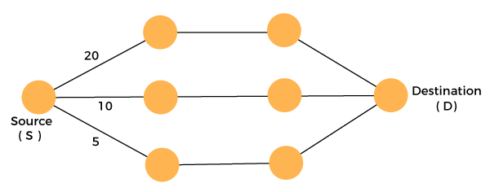
5
3
12
10
8
20

Slide 12
Greedy Problems:
Fractional Knapsack Problem: Given items with weight and value, determine the maximum value of fractions of the items that can be taken into a knapsack of limited weight capacity.
Activity Selection Problem: Given a set of activities with start and finish times, select the maximum number of non-overlapping activities that can be performed by a single person.
Huffman Coding: Given a set of characters and their frequencies, construct a binary tree such that the encoded binary codes for characters have minimum total length.
Coin Change Problem: Given a set of coin denominations and a target amount, find the minimum number of coins needed to make up the target amount.
Job Sequencing Problem: Given a set of jobs with deadlines and profits, find the maximum profit subset of jobs that can be completed within their deadlines.
Minimum Spanning Tree Algorithms: Algorithms like Prim's and Kruskal's are greedy approaches to find the minimum spanning tree in a connected, undirected graph.
Dijkstra's Algorithm: To find the shortest path between nodes in a graph with non-negative edge weights.

Slide 13
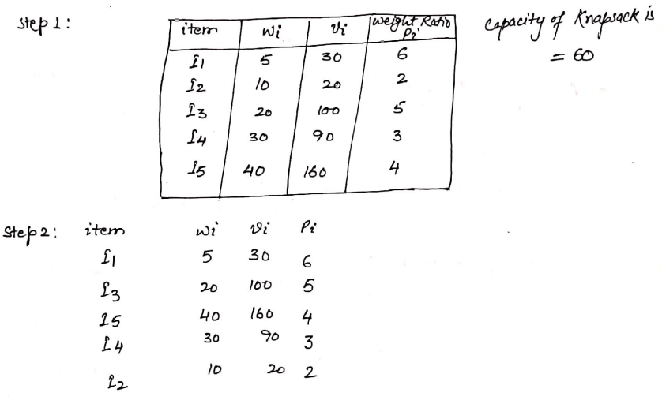
Fractional Knapsack
Given the weights and values of N items, in the form of {weight, Value} put these items in a knapsack of capacity W to get the maximum total profit in the knapsack. In Fractional Knapsack, we can break items for maximizing the total value of the knapsack.
Input: arr[] = {{5, 30}, {10, 20}, {20, 100}, {30, 90}, {40, 160}}, W = 60
Output: 270
Net Selected Value = I1 + I3 + I5*35/40 = 30+100+160*35/40 =270

Slide 14
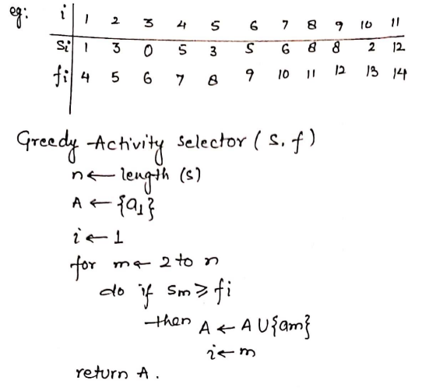
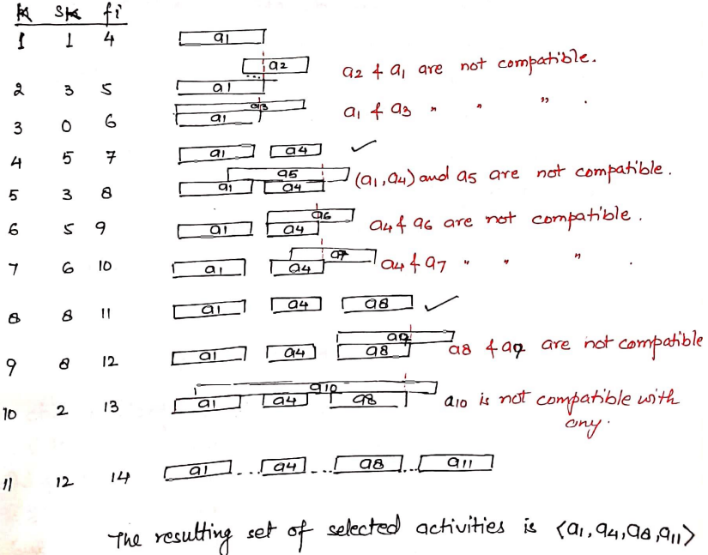
Activity Selection Problem

Slide 15
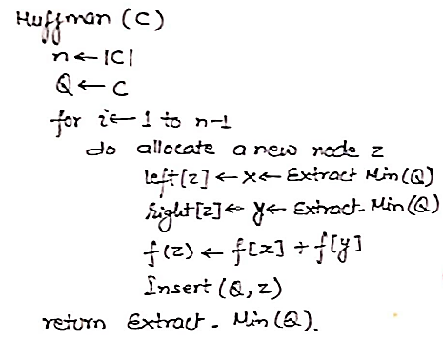
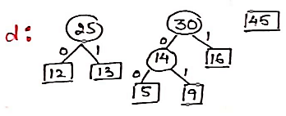
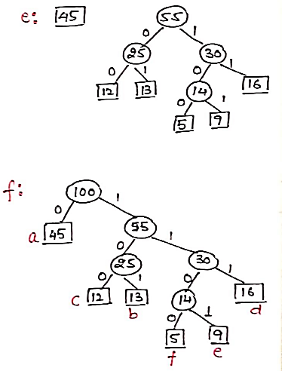
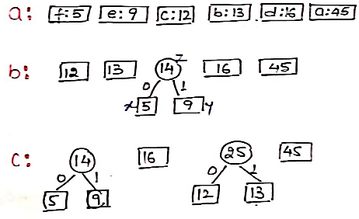
Huffman Code

Slide 16
Coin Change -Greedy
Given a value of V Rs and an infinite supply of each of the denominations {1, 2, 5, 10, 20, 50, 100, 500, 1000} valued coins/notes, The task is to find the minimum number of coins and/or notes needed to make the change?
Examples:
Input: V = 121
Output: 3
Explanation: We need a 100 Rs note, a 20 Rs note, and a 1 Rs coin.
Declare a vector that store the coins.
while n is greater than 0 iterate through greater to smaller coins:
if n is greater than equal to 2000 than push 2000 into the vector and decrement its value from n.
else if n is greater than equal to 500 than push 500 into the vector and decrement its value from n.
And so on till the last coin using ladder if else.

Slide 17
Coin Change -Greedy
Given a value of V Rs and an infinite supply of each of the denominations {1, 2, 5, 10, 20, 50, 100, 500, 1000} valued coins/notes, The task is to find the minimum number of coins and/or notes needed to make the change?
Examples:
Input: V = 121
Output: 3
Explanation: We need a 100 Rs note, a 20 Rs note, and a 1 Rs coin.
Sort the array of coins in decreasing order.
Initialize ans vector as empty.
Find the largest denomination that is smaller than remaining amount and while it is smaller than the remaining amount:
Add found denomination to ans. Subtract value of found denomination from amount.
If amount becomes 0, then print ans.

Slide 18
Practice Problems (Progression)
Easy:
LeetCode 455: Assign Cookies (greedy matching).
LeetCode 121: Best Time to Buy/Sell Stock (single transaction).
Medium:
LeetCode 452: Minimum Arrows to Burst Balloons.
LeetCode 55: Jump Game.
Hard:
LeetCode 621: Task Scheduler (priority queue).
LeetCode 1029: Two City Scheduling (sort by cost difference).

Slide 19
Dynamic Programming
Dynamic Programming (DP) is a method for solving complex problems by breaking them down into simpler sub-problems.
It stores the solutions to sub-problems to avoid redundant calculations.
DP is especially useful when the problem has overlapping sub-problems, such as in the Fibonacci sequence or shortest path problems.
DP is bottom up approach of solving a problem.

Slide 20
Key Principles of Dynamic Programming
Overlapping Sub-problems: The problem can be broken down into smaller sub-problems that are reused several times.
Optimal Substructure: The optimal solution to the problem can be constructed from the optimal solutions of its sub-problems.
Memoization and Tabulation: DP techniques involve either storing solutions in a table (tabulation) or using memoization to cache results of sub-problems.

Slide 21
Dynamic Problems
Fibonacci Series: Calculate the nth Fibonacci number efficiently using dynamic programming to avoid redundant calculations.
0/1 Knapsack Problem: Given a set of items, each with a weight and a value, determine the maximum value that can be obtained by selecting a subset of the items without exceeding the capacity of the knapsack.
Longest Common Subsequence (LCS): Find the longest subsequence that is present in given sequences (strings), in the same order but not necessarily contiguous.
Longest Increasing Subsequence (LIS): Find the length of the longest subsequence of a given sequence such that all elements of the subsequence are sorted in increasing order.
Matrix Chain Multiplication: Given a sequence of matrices, find the most efficient way to multiply these matrices together.
Edit Distance (Levenshtein Distance): Calculate the minimum number of operations required to convert one string into another, where the allowed operations are insertion, deletion, or substitution of a single character.
Coin Change Problem: Determine the number of ways to make change for a given amount using a given set of coin denominations.

Slide 22
Dynamic Problems
Rod Cutting Problem: Given a rod of length n and a price table for different lengths, find the maximum value that can be obtained by cutting the rod into smaller pieces and selling them.
Subset Sum Problem: Determine whether a given set of positive integers can be partitioned into two subsets with equal sum.
Binomial Coefficient: Calculate the number of ways to choose k elements from a set of n elements (binomial coefficient), often denoted as "n choose k".
Bellman-Ford Algorithm: Find the shortest path from a single source vertex to all other vertices in a weighted graph with negative edge weights.
Dynamic Time Warping (DTW): Measure the similarity between two temporal sequences, even if they have different lengths or are out of sync.
Egg Dropping Problem: Determine the minimum number of attempts required to find the critical floor in a building using a certain number of eggs, given that eggs may break when dropped from a certain height.
Maximum Subarray Sum (as Sliding Window): Find the contiguous subarray within a one-dimensional array of numbers that has the largest sum.

Slide 23
Fibonacci Series:
#include <stdio.h>
#include <stdlib.h>
// Function to calculate Fibonacci numbers with memoization
int fibonacci(int n, int* memo) {
// Base case
if (n <= 1) {
return n;
}
// Check if result is already in the memo
if (memo[n] != -1) {
return memo[n];
}
// Perform the computation
int result = fibonacci(n - 1, memo) + fibonacci(n - 2, memo);
// Store the result in the memo
memo[n] = result;
return result;
}
int main() {
// Example usage
int n = 5;
// Initialize memoization table with -1 (indicating that values are not computed yet)
int* memo = (int*)malloc((n + 1) * sizeof(int));
for (int i = 0; i <= n; i++) {
memo[i] = -1;
}
// Calculate and print the result
int result = fibonacci(n, memo);
printf("Fibonacci(%d) = %d\n", n, result);
// Free allocated memory
free(memo);
return 0;
}

Slide 24
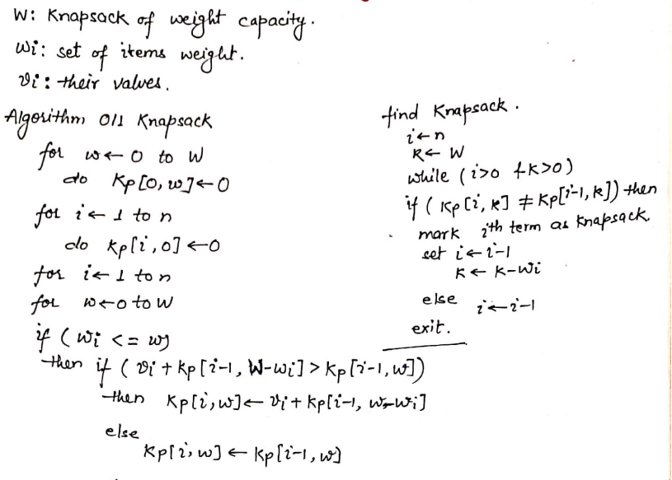
0/1 Knapsack Problem:

Slide 25
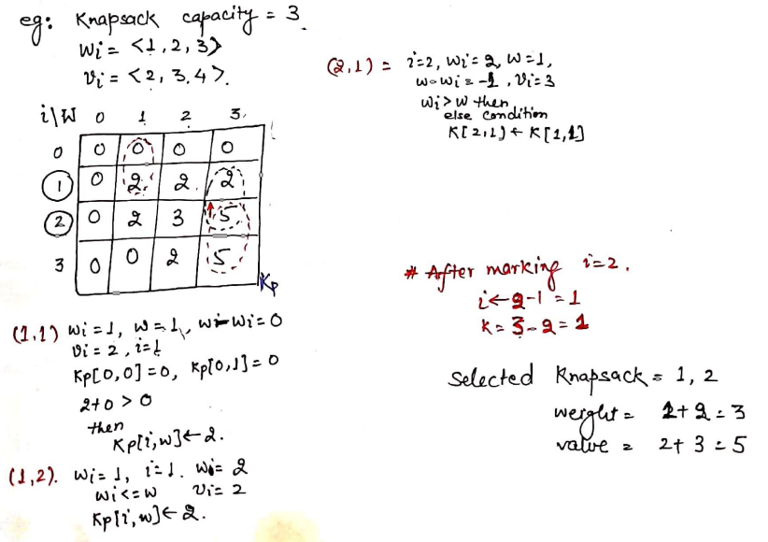

Slide 26
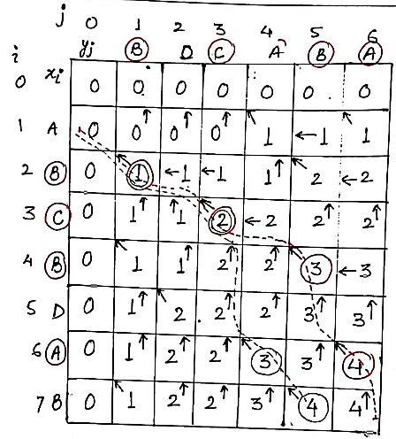
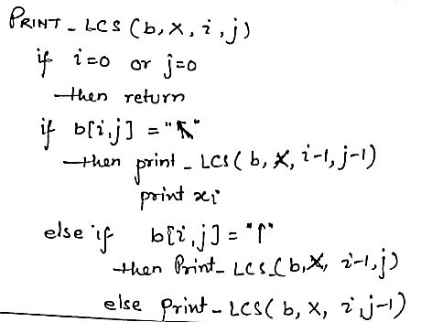
LCS
LCS-Length(X, Y)
m <- length[X]
n <- length[Y]
for i <- 1 to m
c[i,0] <- 0
for j <- 1 to n
c[0,j] <- 0
for i <- 1 to m
for j <- 1 to n
if (x_i == y_j) {
c[i,j] <- c[i-1,j-1] + 1
b[i,j] <- NW
}
else if (c[i-1,j] >= c[i,j-1]) {
c[i,j] <- c[i-1,j]
b[i,j] <- N
}
else {
c[i,j] <- c[i,j-1]
b[i,j] <- W
}

Slide 27
Fibonacci numbers
Coin change problem
Subset Sum Problem
Cutting a Rod
Longest Common Subsequence
Minimum number of jumps to reach end
Floyd Warshall Algorithm
Bellman–Ford Algorithm
0-1 Knapsack Problem
Egg Dropping Puzzle
Vertex Cover Problem
Tile Stacking Problem
Box-Stacking Problem
Travelling Salesman Problem (Dynamic Programming)
Program for Bridge and Torch problem
Matrix Chain Multiplication

Slide 28
Differences Between Greedy and Dynamic Programming
Greedy algorithms make decisions based on the current best choice without considering future consequences, whereas DP evaluates all possible choices.
Greedy algorithms are typically faster and simpler but may not always produce the optimal solution.
DP is more comprehensive and guarantees the optimal solution but can be computationally expensive.

Slide 29
Count number of hops
A frog jumps either 1, 2, or 3 steps to go to the top. In how many ways can it reach the top of nth step.
Input: n = 4
Output: 7
Explanation: Below are the 7 ways to reach 4th step:
1 step + 1 step + 1 step + 1 step
1 step + 2 step + 1 step
2 step + 1 step + 1 step
1 step + 1 step + 2 step
2 step + 2 step
3 step + 1 step
1 step + 3 step

Slide 30
Approach-1: Count number of hops
Create a recursive function (count(int n)) which takes only one parameter.
Check the base cases. If the value of n is less than 0 then return 0, and if value of n is equal to zero then return 1 as it is the starting position.
Call the function recursively with values n-1, n-2 and n-3 and sum up the values that are returned, i.e. sum = count(n-1) + count(n-2) + count(n-3).
Return the value of sum.
O(3^{n})

Slide 31
Approach-2: Using Dynamic Programming-Memoization
// Base cases
if (dist < 0)
return 0;
if (dist == 0)
return 1;
// Check if the value for 'dist' is already computed
if (memo[dist] != -1)
return memo[dist];
// Recur for all previous 3 and add the results
int ways = printCountRecMemo(dist - 1, memo)
+ printCountRecMemo(dist - 2, memo)
+ printCountRecMemo(dist - 3, memo);
// Memoize the result for 'dist' for future use
memo[dist] = ways;
return ways;
Create a recursive function (count(int n)) which takes only one parameter.
Check the base cases. If the value of n is less than 0 then return 0, and if value of n is equal to zero then return 1 as it is the starting position.
Check if the value for 'dist' is already computed
Call the function recursively with values n-1, n-2 and n-3 alongwith its memorized distance and sum up the values that are returned, i.e. ways = countMem(n-1, memo) + countMem(n-2, memo) + countMem(n-3, memo).
Memoize the result for 'dist' for future use & Return the value of ways.

Slide 32
Maximum Subarray Sum – Kadane’s Algorithm
Given an integer array arr[]. You need to find the maximum sum of a subarray.
Input : arr[] = {2, 3, -8, 7, -1, 2, 3} Output : 11 Explanation: The subarray {7, -1, 2, 3} has the largest sum 11.
Input : arr[] = {-2, -4} Output : –2 Explanation: The subarray {-2} has the largest sum -2.
Input: arr[] = {5, 4, 1, 7, 8} Output: 25 Explanation: The subarray {5, 4, 1, 7, 8} has the largest sum 25.

Slide 33
Approach-1: [Naive Approach] By iterating over all subarrays
int maxSubarraySum(vector<int> &arr) {
int res = arr[0];
// Outer loop for starting point of subarray
for(int i = 0; i < arr.size(); i++) {
int currSum = 0;
// Inner loop for ending point of subarray
for(int j = i; j < arr.size(); j++) {
currSum = currSum + arr[j];
// Update res if currSum is greater than res
res = max(res, currSum);
}
}
return res;
}

Slide 34
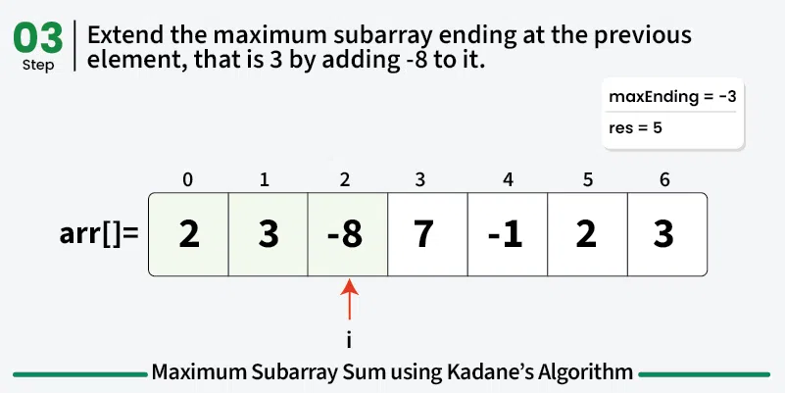
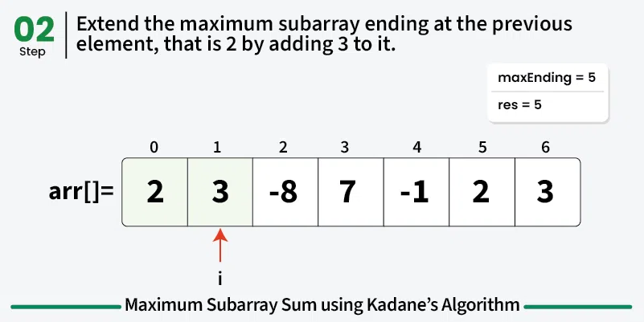
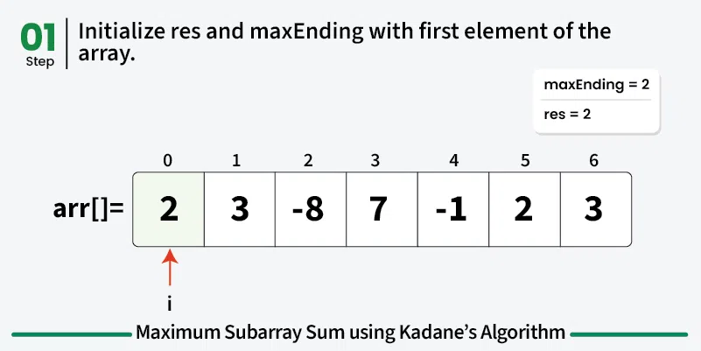
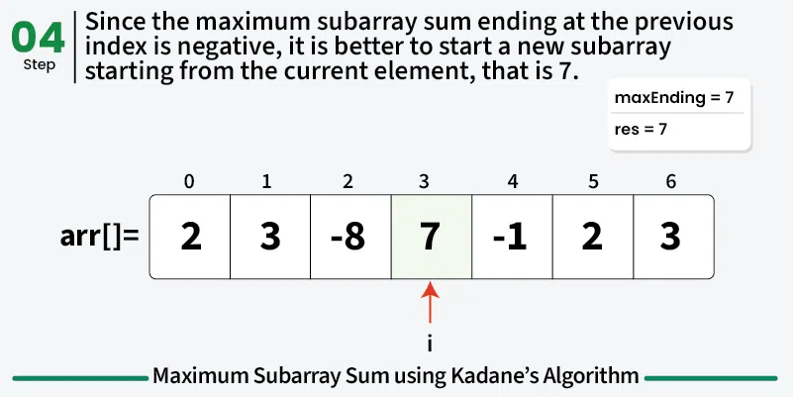
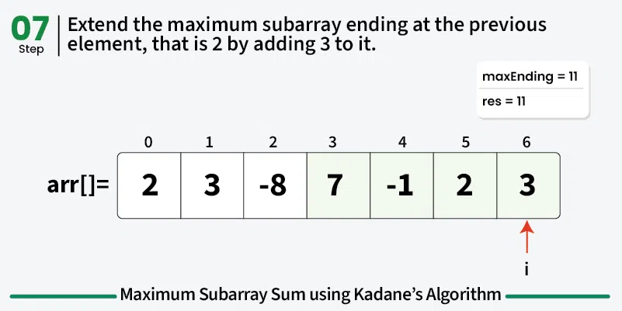
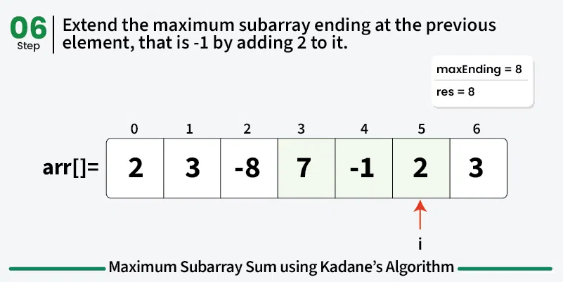
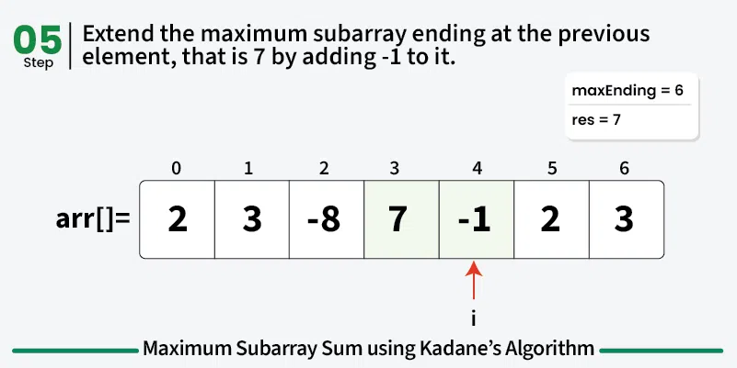
Approach-2: Using Kadane’s Algorithm

Slide 35


Any question?

